Slide 1
Welcome! Find a seat!

Slide 2
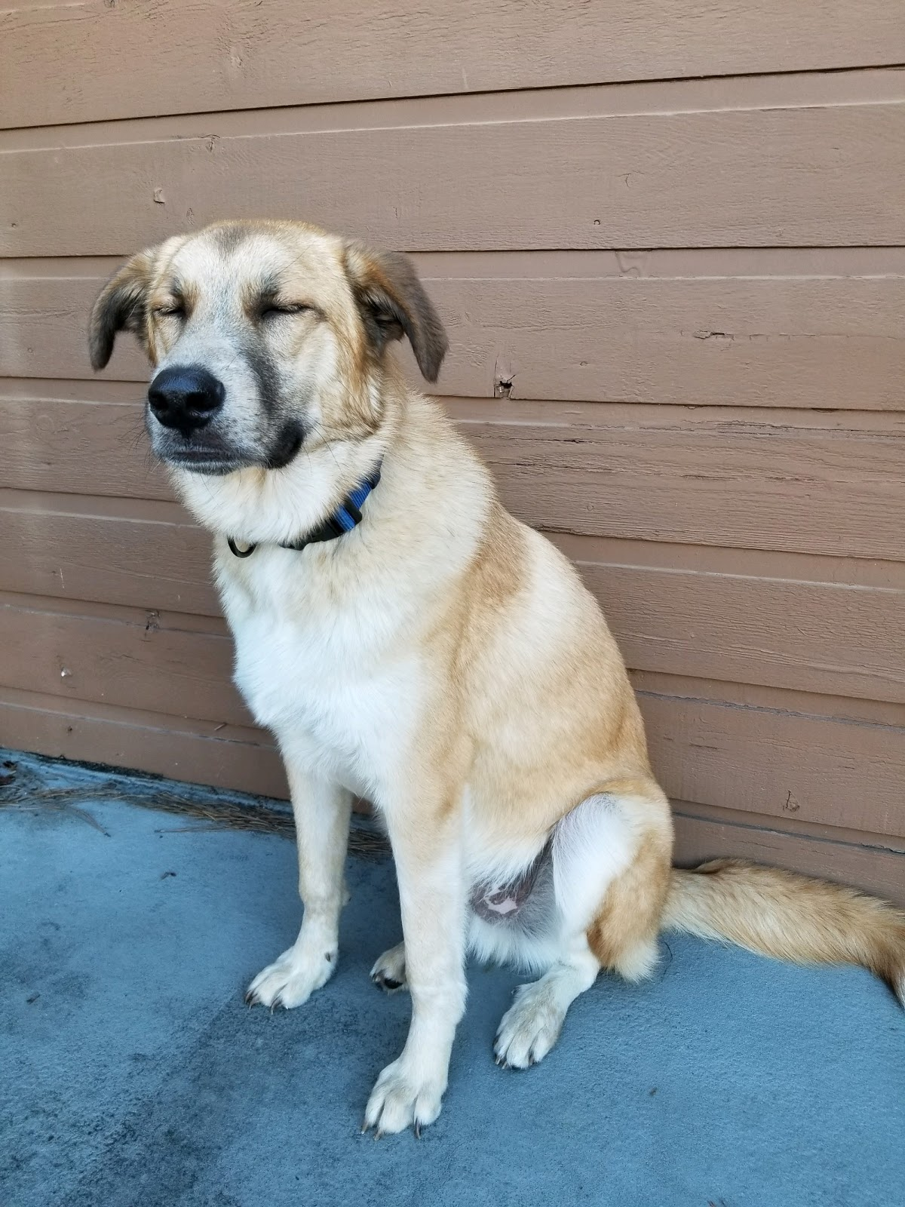
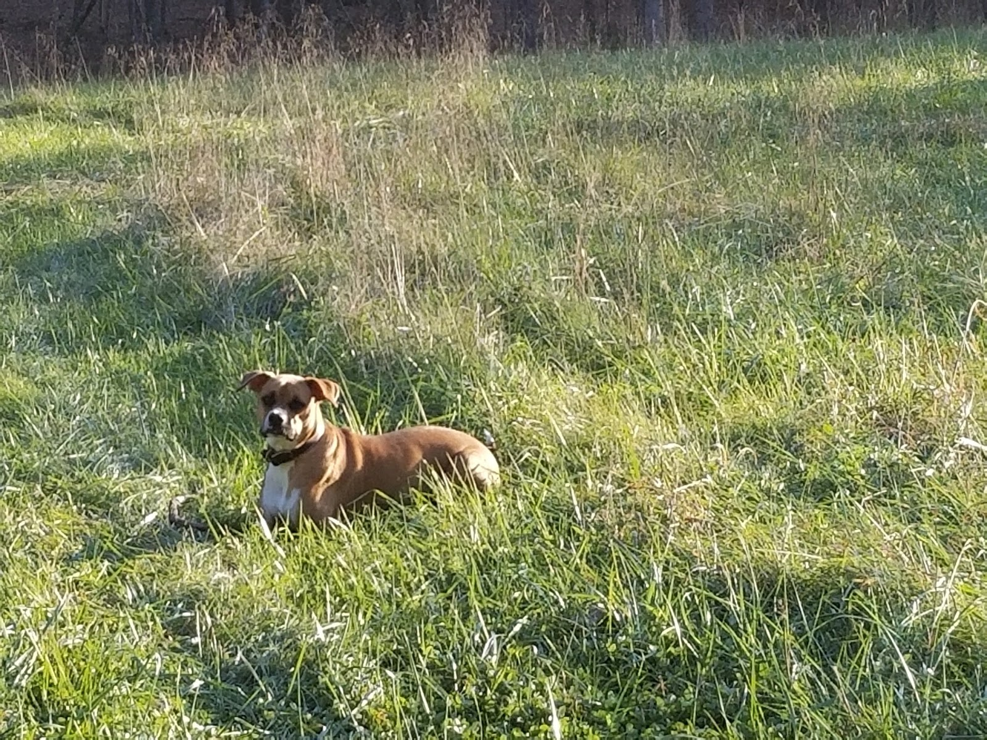
Meet Mrs. Malinda

Slide 3
Contact Information
Email: samanthamalinda@Johnston.k12.nc.us
Website: http://bit.ly/mrsmalindasmathclass

Slide 4
Syllabus – Math 3
Course Topics:
Functions and Inverses
Exponentials and Logarithmic Functions
Polynomials
Rational Functions
Geometry
Parallelograms
Circles and Triangles
Trigonometric Functions
Grading:
Students will be graded on homework, class work, quizzes, special assignments, and tests. All CHS Math classes now work with a points system. Each assignment is given a point value based on the amount of material covered and student work involved. For example, unit assessments cover more material than individual quizzes therefore, will have a higher point value. Students will only be allowed 1 class period to complete major assessments(unless stated in accommodation). Assessments are designed to take less than one full class period.
Prerequisites: Math 1, Math 2
Class Supplies:
Notebook (no later than Wednesday, Jan 8)
1 inch binder or 3 prong folder
Paper
Pencils
TI-83 or Ti-84 calculator
*Optional Supplies: tissues, paper towels, copy paper

Slide 5
Syllabus – Math 3
Reassessments:
Reassessments will be available on all major unit assessments only. Delta Math will be used as the tool for corrections. Students will create account logins. Each unit assessment will have a delta math assignment for students to earn back up to half of points missed on original assessment.
Attendance:
Students who are present in class do better academically. Attendance will be taken daily and it’s the student’s responsibility to make up any missed assignments. Test and quizzes must be made up during COMET time. Students may not have absences, excused or unexcused, exceeding 4 per quarter in order to receive credit for a particular course. That is, if absences from class exceed four per nine weeks, eight per semester the maximum grade a student may receive for the grading period is F or 59, regardless of the reasons for the absences. Absences can be made up by attending tutorials during COMET Time and the discretion of the administration through a waiver process. If a student is tardy twice to a class, it will constitute as one absence.

Slide 6
Complete the following link
bit.ly/malindamath3

Slide 7
Expectations
Student Expectations
Teacher Expectations
As a teacher, what do you think I expect from your in the classroom?
As a student, what do you expect from me as a teacher?

Slide 8
Setting up Delta Math
Grab a Chrome book

Slide 9
This or That?
Everyone stand up
Each slide will have two different selections
You must choose one and go to that side of the room
If you are indecisive, stand in front of the smart board

Slide 10
Chick-fil-a
Bojangles

Slide 11
Dogs
Cats

Slide 12
Football
Basketball

Slide 13
Sneakers
Sandals

Slide 14
coke
pepsi

Slide 15
Summer
Winter

Slide 16
Snap Chat
Tik tok

Slide 17
TV
Music

Slide 18
Introvert
Extrovert

Slide 19
Honesty
Other’s Feelings

Slide 20
College
Trade School/
Work/Military

