Slide 1
Grab a quiz review from the table and a glue stick
Start working on your quiz review

Slide 2
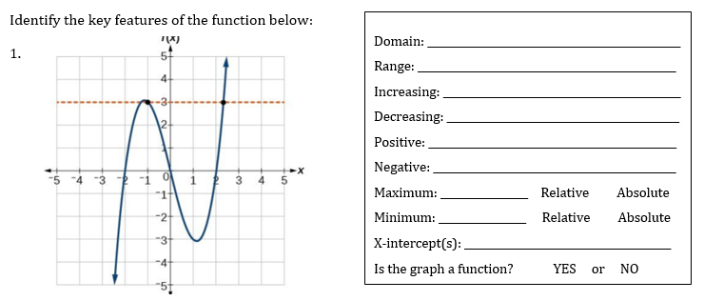
Quiz REview

Slide 3
Quiz REview

Slide 4
Quiz Time
You have until the end of class to finish this quiz

